Slide 1
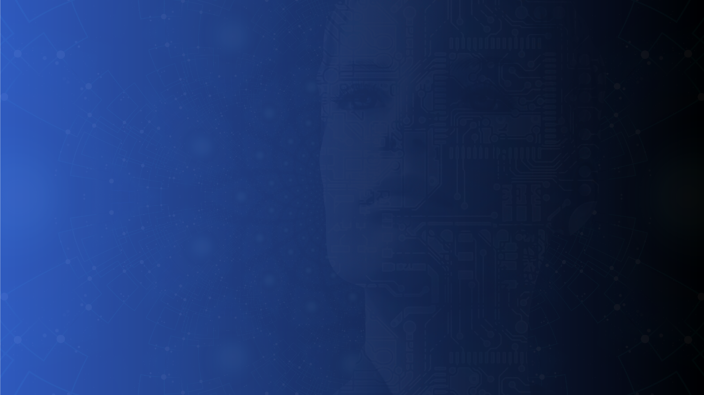


PRIMARY
T O P I C S
P R E S E N T A T I O N
01

Slide 2

CLOUD COMPUTING
N A M E
: H A R I P R A S A D
U
SELECTED ROLE : CLOUD ENGINEER
TASK 1 :TOPIC PRESENTATION
02

Slide 3

OBJECTIVES
U N D E R S T A N D C O M P U T I N G
C L O U D
F U N D A M E N T A L S
L E A R N C O R E
A W S A N D S E R V I C E S
A Z U R E
E | X | P | L | O | R | E |  | S | E | R | V | E | R | L | E | S | S | A | N | D
C | O | N | T | A | I | N | E | R | - | B | A | S | E | D
A | R | C | H | I | T | E | C | T | U | R | E | S
U | N | D | E | R S |  | T | A | N | D | D | E | V | O P M E |  |  |  | N T | ,
S E |  | C | U | R | I T Y , |  |  |  | A | N D |  | S | Y | S | T | E | M
D E |  | S | I | G | N C O |  |  | N | C | E P | T | S
03

Slide 4










CLOUD COMPUTING
RENTING COMPUTING RESOURCES OVER THE INTERNET
NO PHYSICAL SERVER OWNED
ON-DEMAND RESOURCE PROVISIONING
PAY-AS-YOU-GO PRICING MODEL
SCALABLE AND FLEXIBLE INFRASTRUCTURE
04

Slide 5



CLOUD SERVICE MODEL
IAAS
PAAS
SAAS
we get virtual machines,storage,network,IP address.
we manage OS,Application code,Security.
cloud provider manages physical server,data center hardware.
we get OS,Runtime,web server database support.
we manage only the application code.
cloud provider manages server,OS,scaling,security updates
we get complete application,no installation,no ,aimtenance.
we just use the software. cloud manages everything
ex,..Amazon EC2,Azure VM’s
ex,.Azure app service,AWS Elastic Beanstalk.
ex,..Gmail,Google Docs,Office 365
05

Slide 6

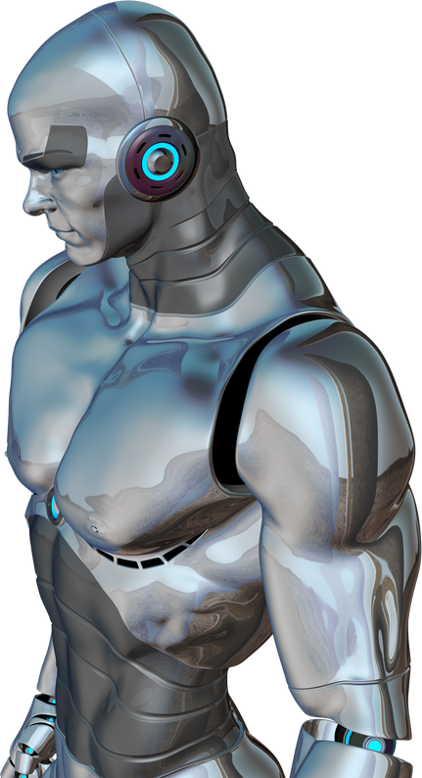
SCALABILITY VS ELASTICITY
SCALABILITY: Ability of a system to handle increased workload by adding resources when needed(planned). ex,. today =1 server, tomorrow =2 server .(server increased manually when needed)
TYPES OF SCALING
HORIZONTAL SCALING - incresing number of servers (1 SERVER TO 5 SERVERS)
VERTICAL SCALING - increasing server size(4GB TO 8GB)
ex,...increase EC2 instance size,Add EC2 instance manually.
ELASTICITY:Ability of a system to automatically adjust resources in real time based on demand.
ex,. Traffic increses = servers added automatically,Traffic decreases = server removed automatically. no manual actions.
ex,...Lambda (serverless is fully elastic)
06

Slide 7

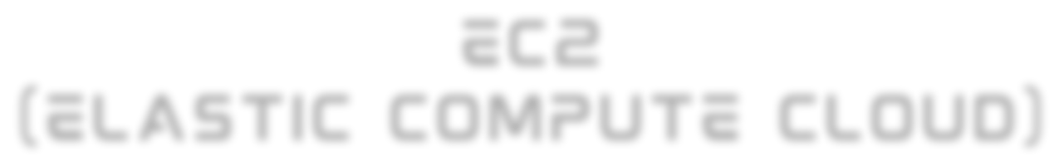
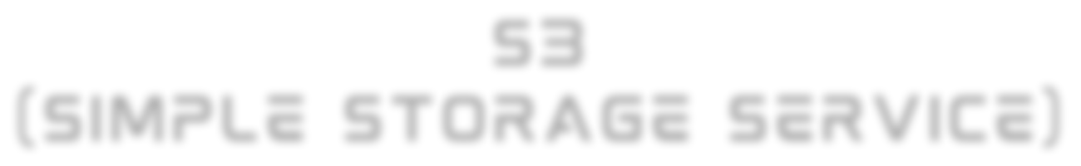




AWS CORE SERVICES
EC2
(ELASTIC COMPUTE CLOUD)
S3
(SIMPLE STORAGE SERVICE)
DYNAMO DB
compute virtual servers in cloud
used for:
Hosting applications
Running Linux/Windows servers Web servers, backend servers practice linux.
its a o unlimited object storage
Stores data like: Images Videos Backups Logs
it uses 11-nines durability
it uses buckets to organise data
Fully managed NOSQL database. automated scaling
very fast and flexible millisecond response time and manages millions od data.
used for:
high traffic app,gaming,IOT.
LAMBDA
API GATEWAY
no server management event driven
pay only when code runs serverless compute service auto scaling
it allows runnning code without provisioning or managing server. COST EFFICIENT(no Event-no cost)pay per execution & duration.
execution time (only 15 mins)
client cannot call lambda and run code easily.(so it exposes our backend services as HTTP API’s)
IT HANDLES:
Routing,Authentication,Rate limiting &Request validation.
FLOW:
it recieve request - trigger lambda - lambda processes - it stores/retrives data from dynamo db-response back to user.
07

Slide 8





AZURE CORE SERVICE
AZURE FUNTION
same as lambda. event driven.
it is stateless in nature. execution time (upto 60 mins)based on plan. auto scaling
BLOB STORAGE
it is same as S3 .
it stores object datas. highly scalable,low
cost,durable,accessible from everywhere.
it uses containers to organise data.
COSMOS DB
its a fully managed NOSQL databse.
with high availability(multi region)
with low latency,auto scaling,serverless.
it supports multiple API’s-SQL API,MongoDB API,Table API,Cassandra API
APP SERVICES
it is a PAAS
in this we can deploy web apps,REST API’s,backend services.
a service to deploy application without managing servers
08

Slide 9







IAC
(INFRASTRUCTURE AS CODE)
IAC()INFRASTRUCTURE AS CODE -IN this it manages the cloud infrastructure using the code instead of manual setup we write code-deploys infrastructure automatically.
IAC ensures consistent and repeatable infrasrtucture provisioning.
IAC HAS TWO TYPES
IMPERATIVE - DEFINES HOW TO CREATE-STEP BY STEP ex,...AWS CDK
DECLARATIVE- DEFINES WHAT YOU WANT.
ex,...AZURE BICEP
AWS CDK(CLOUD DEVELOPMENT KIT)
AZURE BICEP
AWS CDK let you define the cloud infrastucture using the programming language
it uses languages like python,typescript,java.
AWS CDK WORKS LIKE-write infrastructure code-CDK converts it to cloud formation-AWS creates resources.
Azure bicep is a declarative language used to define Azure infrastructure.
Bicep output is ARM templates
bicep uses the DSL Domain specific language for code.
USING BICEP, WECAN CREATE:
Virtual Machines,Virtual Networks (VNet),Subnets,Storage Accounts,App Services,Azure Functions,Databases (SQL, Cosmos DB),Entire architectures.
simple syntax and less coding
ex,.....
create Lambda create API Gateway
create Dynamo DB table
ALL BY CODE
09

Slide 10
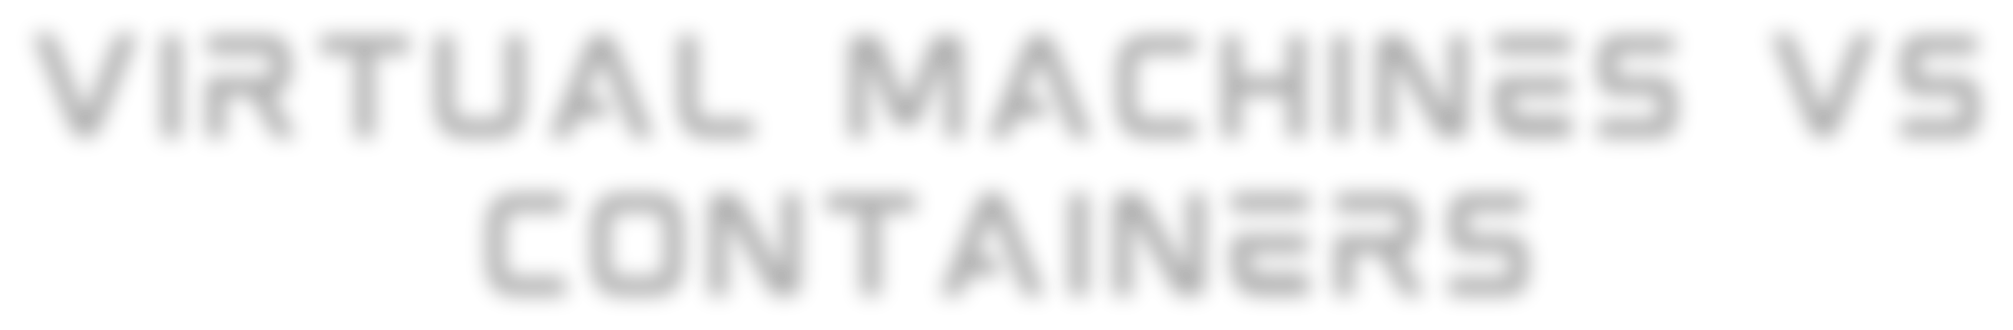






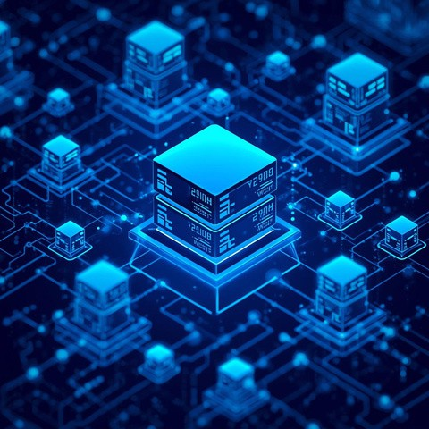

VIRTUAL MACHINES VS CONTAINERS
VIRTUAL MACHINES
it has own OS,own Disk,CPU and RAM it is strong and isolation.
can run different OS(Windows,Linux) heavy and more resource usage.
ex,..EC2,Azure VM’s
CONTAINERS
it shares Host OS ,unlike VM’s very lightweight
fast startups
less resource usage
easy to move between systems(runs the same everywhere)
DOCKER
package an application with its dependencied into a container.
docker is a containerization platform used to built and run applications consistenly.
a docker file contain the instruction to built docker image.
DOCKER IMAGE:its a read only template used to create container. DOCKER CONTAINER:it created from a docker image and its a running application
ex,. njinx-webserver or python application

Slide 11



CONTAINER ORCHESTRATION
ECS
(ELASTIC CONTAINER SERVICE)
EKS (ELASTIC KUBERNETS
SERVICE)
AKS
(AZURE KUBERNETES SERVICE)
ECS is AWS’s native container orchestration service(AWS-built) no - kubernetes complexity
it has deep aws integration. easy to access
EKS is a AWS managed kubernets service.
EKS run standard Kubernetes on AWS without managing the control plane.
EKS is industry standards we use EKS for multi cloud protability
AKS is a Azure managed kubernets service kubernet based.
azure manages control panel. high azure integration(V-Net & AD)
it can run on: EC2

Slide 12

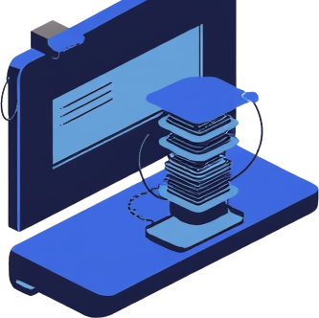
SERVERLESS ARCHITECTURE
its an event driven execution model serverless means we dont mange the servers we write code only.
servers do exist,but we dont manage.
cloud provider manages the server,scaling,availability and maintanance.
cost efficient(pay only when code runs)
SERVERLESS ARCHITECTURE FLOW
User / Client
↓
API Gateway
↓
Serverless Function
↓
Database / Storage

Slide 13






CI/CD PIPELINES
CI/CD it connects docker,serverless,containers and cloud into real production workflow
CI-CONTINOUS INTEGRATION
-code is pushed to git and automatically build,test and validate
CD-CONTINOUS DEPLOYMENT
-automatically deploys the code
it catches and eliminates error easily Enables faster delivery
CI/CD pipelines automate building, testing, deploying, and monitoring applications, enabling faster, safer, and more reliable software delivery
CI/CD FLOW
Developer
Git Repository build&test(CI) Package(Docker/Zip)
Deploy to cloud(CD)
13

Slide 14








IAM
(IDENTITY AND ACCESS MANAGEMENT)
control who can access what in the cloud is the work of IAM
AUTHENTICATION -
AUTHORIZATION -
it verifies identity that who you are? ex,.username-password,OTP,OAuth,access keys. first we authenticate
it gives the permission that what can you do? ex,..can read but can’t write. after authentication -authorization happens
IAM is a service that manages the authentication and the authorization in cloud platform
IAM
CORE
COMPONENTS
AUTHENTICATION
in AWS
- username&password
IAM ROLE
- permission without a user
user group role policy
individual person
collection of users
temporary permission
permission rules
ex,...Used by:
EC2 accessing S3
Lambda accessing DynamoDB Cross-account access
AUTHORIZATION
in AWS
- IAM policy
RBAC(ROLE BASED ACESS CONTROL)
RBAC means the permissions are assigned to roles not directly to the users.
RBAC FLOW FORM
users get roles
roles
defime permission
RBAC IN AZURE
AWS IAM as AZURE AD
IAM Role as Role
Policy Attchment as Role Assignment
ex,...Reader role - view only owner - full access
14

Slide 15





CDN (CONTENT DELIVERY NETWORK)
CDN
A CDN is a network of servers distributed globally that deliver content from the nearest location to the user.CDN brings content closer to users.
Images,Videos,CSS / JS,Static HTML,Downloads are go through CDN
CLOUD CDN EXAMPLES
AWS CloudFront Azure CDN
Google Cloud CDN
COACHING
storing frequently accessed data in a faster storage layer.so it can be served quickly.
TYPES OF CACHING (SYSTEM DESIGN)
Browser Cache-Stored in user’s browser-Controlled by headers (Cache-Control) CDN Cache-Stored at CDN edge-Reduces load on origin server
Application Cache-Stored in memory (Redis, Memcached) Database Cache-Query results cached
Popular Cache Tools - Redis,Memcached,CDN edge cache
GLOBAL SCALING ARCHITECTURE
USERS (WORLD-WIDE)
↓
DNS (GEO-BASED ROUTING)
↓
CDN (EDGE LOCATIONS)
↓
REGIONAL LOAD BALANCERS
↓
AUTO SCALING APP SERVERS
↓
DATABASES (REPLICATION)
GLOBAL SCALING
Serving millions of users worldwide with : Low latency,, High availability,No downtime
KEY TECHNIQUES FOR GLOBAL SCALING
Multi-Region Deployment - Same app deployed in multiple regions,Failover if one region goes down
Geo-DNS Routing - Route users to nearest region.
Stateless Applications - No user session stored on server,Enables easy scaling. Database Replication - Read replicas,Global databases

Slide 16







LLM API’S IN CLOUD
Deploying AI Inference Endpoints using Serverless Functions
Clients (web/mobile/apps) call your API → backend talks to an LLM → returns the AI response.
An LLM API send : a prompt (text),optional parameters (temperature, max tokens)
An LLM API receive : generated text,summaries,answers,code,chat responses Ex,.....OpenAI APIs,Azure OpenAI,Amazon Bedrock
SERVERLESS AI ARCHITECTURE
Clients (web/mobile/Client (Web / Mobile / App)
↓
API Gateway (HTTPS endpoint)
↓
Serverless Function (Lambda / Azure Function)
↓
LLM API (OpenAI / Azure OpenAI)
↓
Response → Client
.
LIMITATIONS
SCALING & PERFORMANCE
Horizontal scaling automatically One function instance per request Combined with:
CDN (CloudFront) Caching (Redis)
Async queues (SQS / Service Bus)
Cold start latency Execution time limits
Not ideal for very large on-GPU models
FOR HOSTED LLM APIS, SERVERLESS IS PERFECT.

Slide 17

THANKYOU!

